Slide 1

Credit Card Approval Prediction
Intro to Business Analytics
Team 0123
Bradley Ge
Jim Tiao
Irene Wang
Ella Lee
Ray Pan

Slide 2
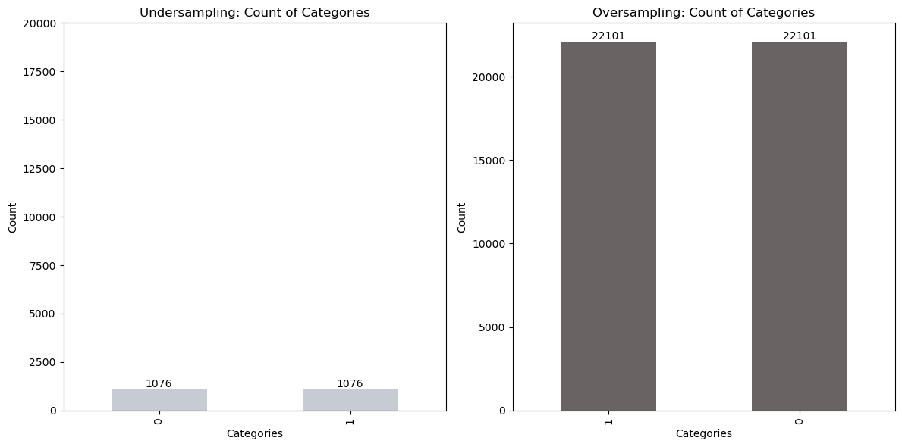
Executive Summary
Undersampling VS Oversampling
Results
 | Oversampling | Undersampling | SMOTE
Tree Decision | Accuracy: 0.9319 Precision: 0.9664 Recall: 0.9623 F1 Score: 0.9643 Confusion Matrix: [[ 120 318] [ 358 9137]] | Accuracy: 0.5364 Precision: 0.9720 Recall: 0.5303 F1 Score: 0.6862 Confusion Matrix: [[ 293 145] [4460 5035]] | Best accuracy score: 0.9587
Logistic | Accuracy: 0.5688 Precision: 0.9657 Recall: 0.5691 F1 Score: 0.7162 Confusion Matrix: [[ 246 192] [4091 5404]] | Accuracy: 0.5564 Precision: 0.9646 Recall: 0.5564 F1 Score: 0.7057 Confusion Matrix: [[ 244 194] [4212 5283]] | Best accuracy score: 0.8538
kNN | Accuracy: 0.9291 Precision: 0.9719 Recall: 0.9534 F1 Score: 0.9626 Confusion Matrix: [[ 176 262] [ 442 9053]] | Accuracy: 0.5955 Precision: 0.9747 Recall: 0.5922 F1 Score: 0.7368 Confusion Matrix: [[ 292 146] [3872 5623]] | Best accuracy score: 0.9467
After employing under-sampling, over-sampling, and SMOTE techniques to address data imbalance, we determined that the combination of SMOTE and the Decision Tree algorithm (Best parameters for DecisionTreeClassifier: {'max_depth': None, 'min_samples_leaf': 1, 'min_samples_split': 2}) achieved the highest out-of-sample accuracy.

Slide 3
Content
Data Understanding
Modeling and Evaluation
1
2
3
4
5
Business Understanding
Data Preparation
Deployment

Slide 4
Part 01
Business Understanding

Slide 5




Business Understanding: Credit Card Business
Credit Check & Approval
Application
Submission
● Credit card business collect interests from cardholders who carry a balance as well as fees such as late payment fees.
● Credit Card Business’s Main Costs are
Cost of Funds: Money borrowed to lend to customers, by paying interest.
Credit Losses: Not all cardholders will pay back their debt.
● The credit card approval process is crucial to offset these expenses.

Slide 6
Business Understanding:
How can our model improve credit card business?
In banking, precise credit card approval models enable rapid eligibility assessment and informed credit exposure decisions for applicants.
Use Scenario
Risk Mitigation
Reducing financial losses by identifying high-risk credit card applicants.
Operational Efficiency
Business Value
Streamlining review process, thus enhancing efficiency in application processing.
Customer Retention
By providing an efficient and seamless credit card application process, financial institutions can retain customers, fostering long-term relationships.

Slide 7

Business Understanding:
Assess Applicant's Creditworthiness
● Applicants to Basic/Standard Card have lower credit score tier, with higher utilization rate
● More applicants, with limited or average credit, apply for Basic/Standard Card.
Objective: Precisely determine if credit card applicants are fit for a basic/standard card.

Slide 8
Part 02
Data
Understanding

Slide 9
Data Understanding: Datasets
Application_record dataset
18 columns (including ID), 438,463 rows
Customers’ personal information (gender, income, education level, whether own a car, etc.)
Credit_record dataset
3 columns (including ID), 1,048,575 rows
‘MONTHS_BALANCE’
0 represents the current month, -1 represents the previous month, and so on.
‘STATUS’ = Check if a customer is overdue for that month or not
0: 1-29 days past due 1: 30-59 days past due 2: 60-89 days overdue 3: 90-119 days overdue 4: 120-149 days overdue 5: Overdue or bad debts, write-offs for more than 150 days C: paid off that month X: No loan for the mont

Slide 10
Data Understanding: Types of Features
Application_record dataset
Most of the features are categorical variables (13 out of 18 columns, including ID)
binary: gender, whether own a car, whether own a property, etc.
polynomial: income_type, education_type, etc.
Five of the columns are numerical features
annual income, count_children, days_birth, days_employed, family size, etc.
Credit_record dataset
One of the features is numerical
months_balance
Two of the features are categorical (Including ID)
Polynomial: status

Slide 11
Data Understanding: Datasets example
Application_record dataset
ID | CODE_GENDER | FLAG_OWN_CAR | FLAG_OWN_REALTY | CNT_CHILDREN | AMT_INCOME_TOTAL
5008804 | M | Y | Y | 0 | 427500
5008805 | M | Y | Y | 0 | 427500
5008806 | M | Y | Y | 0 | 112500
5008808 | F | N | Y | 0 | 270000
5008809 | F | N | Y | 0 | 270000
Credit_record dataset
ID | MONTHS_BALANCE | STATUS
5001711 | 0 | X
5001711 | -1 | 0
5001711 | -2 | 0
5001711 | -3 | 0
5001712 | 0 | C

Slide 12
Data Understanding: Exploring the Data
Exploring the data:
Check duplicates and missing values
Summary Statistics
Number of users: 33,110
Average number of children: 0.428
Average Income: 185,877
Average days employed: 60,031
These two tables are connected by ID (We first used inner join to merge these two tables as we needed both information from each dataset)

Slide 13
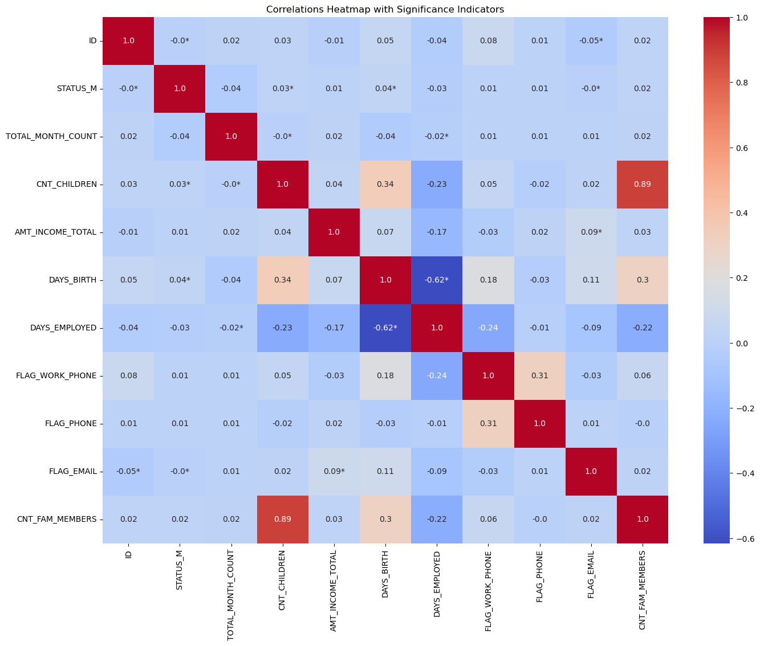
Data Understanding: Correlation Heatmap

Slide 14
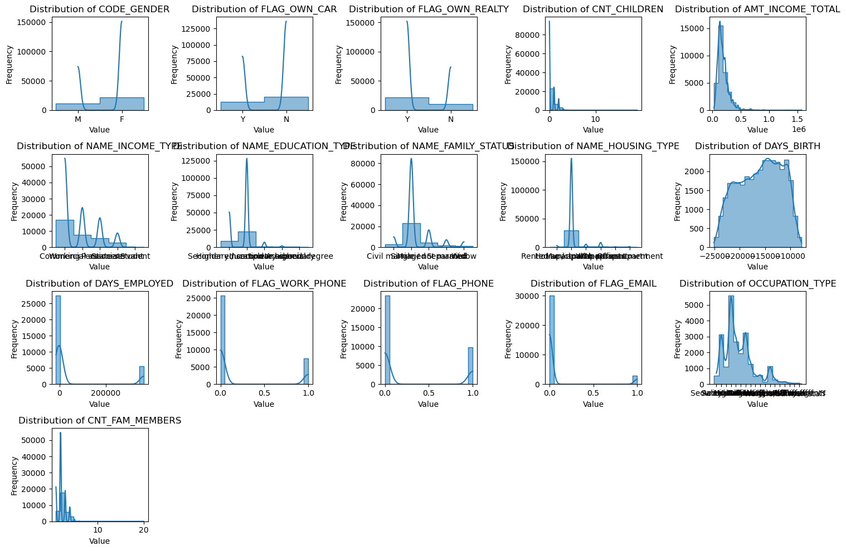
Data Understanding: Attributes Distribution

Slide 15
Part 03
Data Preparation

Slide 16
Data Preparation: Data Cleaning
Table Columns
Data Cleaning & Feature Engineering
Attributes | Gender | Binomial
 | Car | BInomial
 | Realty | BInomial
 | Child | INT
 | Income | Float
 | Education | Polynomial
 | Family_status | Polynomial
 | Age | INT
 | Occupation | Polynomial
1
Drop Duplicates
2
One-hot encoding
3
Missing Value imputation:
Use predictive imputations to fill missing values in occupation type
Column’s for Target Variable | MONTHS_ BALANCE | INT
 | STATUS | Binomial

Slide 17
Data Preparation: Data Cleaning
Data Cleaning & Feature Engineering
1
Drop Duplicates
2
One-hot encoding
3
Missing Value imputation
Issues related to application data
Duplicate IDs: The uniqueness of IDs possibly from data input error. As this can lead to duplicates when merging with the credit status data, we will remove these duplicate IDs from the application dataset.

Slide 18
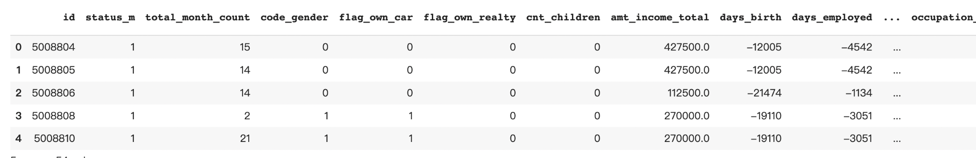
Data Preparation: Data Cleaning
Data Cleaning & Feature Engineering
1
Drop Duplicates
2
One-hot encoding
3
Missing Value imputation
CODE_GENDER:
Male: 1
Female: 0
FLAG_OWN_CAR:
Yes: 1
No: 0
FLAG_OWN_REALTY:
Yes: 1
No: 0
One-hot encoding is a technique used to convert categorical data, represented as text labels, into a binary format that can be easily used by machine learning algorithms. Each category in a categorical column is converted into a binary column (0 or 1), where 1 indicates the presence of that category and 0 indicates the absence. Let's apply one-hot encoding to the given columns:

Slide 19
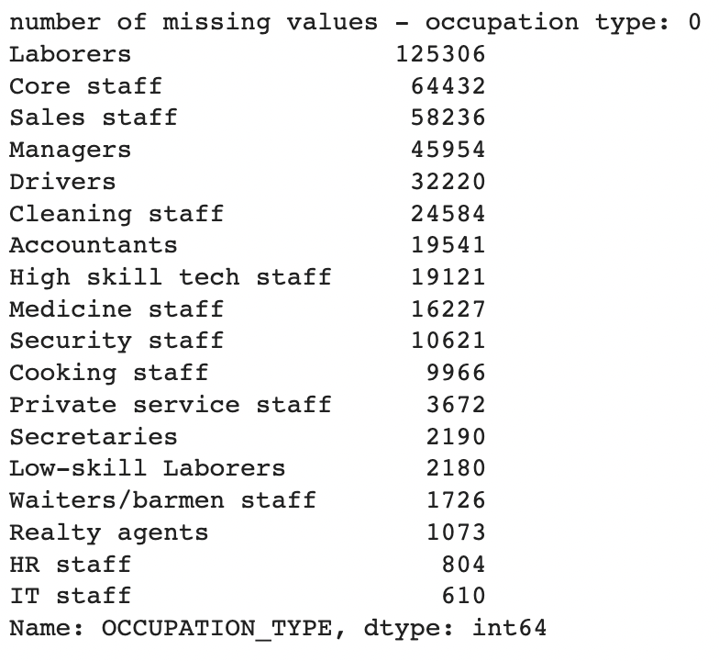
Data Preparation: Data Cleaning
Data Cleaning & Feature Engineering
1
Drop Duplicates
2
One-hot encoding
3
Missing Value imputation
Use predictive imputations to fill occupation type missing values
Employs a machine learning model (RandomForestClassifier) to predict and impute missing values in the 'OCCUPATION_TYPE' column of the dataset.
It first prepares the data, then trains the model on the available data, and finally uses the trained model to predict and fill in the missing values, effectively making the dataset more complete and suitable for further analysis or modeling.

Slide 20
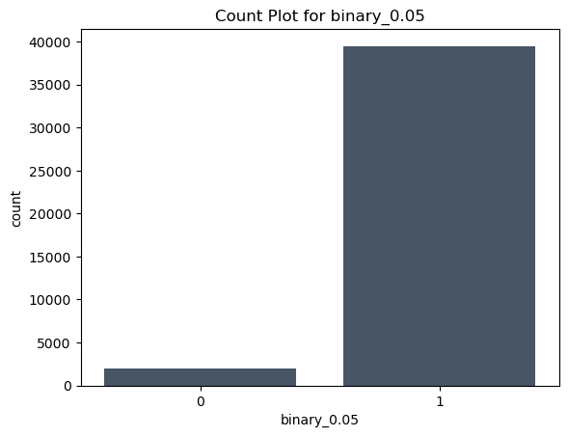
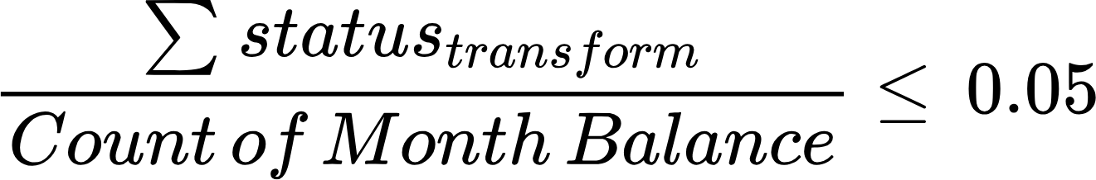
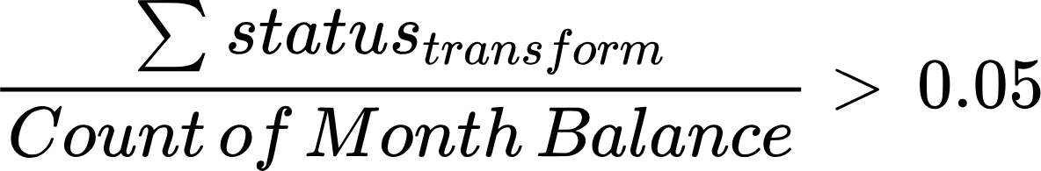
Data Preparation: Target Variable
Table Columns
Status Transform
Transform Outcome
Attributes | Gender | Binomial
 | Car | BInomial
 | Realty | BInomial
 | Child | INT
 | Income | Float
 | Education | Polynomial
 | Family_status | Polynomial
 | Age | INT
 | Occupation | Polynomial
Status | Count | Status_Transform (Good = 0, Bad = 1)
C | 442031 | Good
0 | 383120 | Bad
X | 209230 | Will be dropped
1 | 11090 | Bad
5 | 1693 | Bad
2 | 868 | Bad
3 | 320 | Bad
4 | 223 | Bad
Default Threshold
Under Sampling & Over sampling
Good Credit Customer (y = 0)
Column’s for Target Variable | MONTHS_ BALANCE | INT
 | STATUS | Binomial
Bad Credit Customer (y = 1)

Slide 21
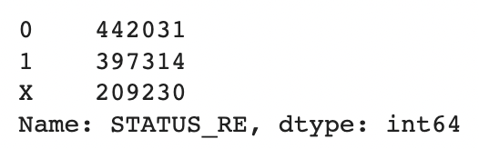
Data Preparation: Target Variable
Table Columns
Status Transform
Column’s for Target Variable | MONTHS_ BALANCE | INT
 | STATUS | Binomial
Status | Count | Status_Transform (Good = 0, Bad = 1)
C | 442031 | Good
0 | 383120 | Bad
X | 209230 | Will be dropped
1 | 11090 | Bad
5 | 1693 | Bad
2 | 868 | Bad
3 | 320 | Bad
4 | 223 | Bad
Output (Good = 0, Bad = 1)
There are 8 different status in this column, since we are trying to do a binary classification task, we will have to make some changes to this column.
First, we delete the X status since they are not using the credit card at all. Second, we define customers who didn’t repay their credit cards on time as target risk customers(Status 0, 1, 2, 3, 4, 5), those samples are marked as '1', else are '0' (Status C).

Slide 22
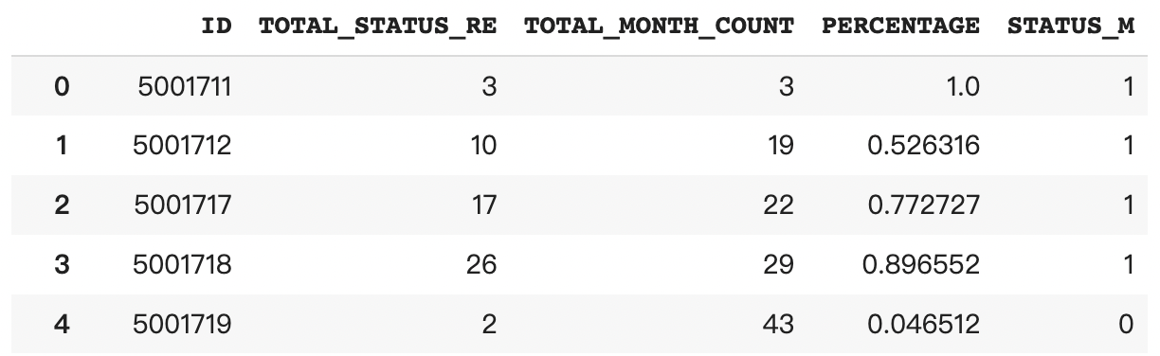
Data Preparation: Target Variable
Table Columns
Default Threshold Setting
Column’s for Target Variable | MONTHS_ BALANCE | INT
 | STATUS | Binomial
Good Credit Customer (y = 0)
Based on the information provided in the "credit_record.csv" table, we will create a binary classification system for customers, categorizing them as either "good" or "bad" customers.
A customer will be classified as "bad" if their default rate, which is calculated as the count of defaults divided by the total number of months, exceeds 0.05.
Bad Credit Customer (y = 1)
Output (Good = 0, Bad = 1)

Slide 23
Data Preparation: Target Variable
Table Columns
Transform Outcome
Undersampling & Oversampling
Column’s for Target Variable | MONTHS_ BALANCE | INT
 | STATUS | Binomial
Dealing with Imbalance Data
Undersampling and oversampling are techniques used to tackle class imbalance in machine learning datasets.
Undersampling involves randomly reducing the number of instances in the majority class, aligning it with the minority class. While it can expedite training, it may lead to information loss as valuable data points are discarded.
Oversampling increases the number of minority class instances by either replicating data or generating synthetic examples. It retains all data but may risk overfitting if not carefully implemented.
The choice between undersampling and oversampling depends on factors like dataset size and class distribution. Sometimes, a combination of both methods is used for optimal results. Experimentation and model performance validation help determine the most effective strategy. Techniques like SMOTE offer controlled oversampling to mitigate some downsides.

Slide 24
Part 04
Modeling and Evaluation

Slide 25
Modeling
Problem Type
Supervised + Categorical
We are trying to classify these appliers into potential good or bad users. This classification is pivotal as it allows us to leverage the model for predicting an applier's eligibility for obtaining a credit card.
Split Test / Train Data
Test data/Train data = 0.3
Test data/Train data = 0.3" means 30% of the dataset is reserved for testing machine learning models, ensuring their ability to generalize to new, unseen data.
Classification Model
Decision Tree
Logistic Regression
kNN
dt_params = {
'max_depth': [None, 5, 10, 15],
'min_samples_split': [2, 5, 10],
'min_samples_leaf': [1, 2, 4]}
lr_params = {
'C': [0.001, 0.01, 0.1, 1, 10, 100],
'solver': ['newton-cg', 'lbfgs', 'liblinear', 'sag', 'saga']}
knn_params = {
'n_neighbors': [3, 5, 7, 9, 11],
'weights': ['uniform', 'distance'],
'metric': ['euclidean', 'manhattan']}
Hypertuning &
Cross Validation
Cross Validation = 10
Cross Validation = 10" indicates using 10-fold cross-validation, a technique that divides the data into 10 subsets for robust model evaluation and performance assessment.
Evaluation

Slide 26
Evaluation: Under sampling & Over sampling & SMOTE
Undersampling VS Oversampling
Results
 | Oversampling | Undersampling | SMOTE
Tree Decision | Accuracy: 0.9319 Precision: 0.9664 Recall: 0.9623 F1 Score: 0.9643 Confusion Matrix: [[ 120 318] [ 358 9137]] | Accuracy: 0.5364 Precision: 0.9720 Recall: 0.5303 F1 Score: 0.6862 Confusion Matrix: [[ 293 145] [4460 5035]] | Best accuracy score: 0.9587
Logistic | Accuracy: 0.5688 Precision: 0.9657 Recall: 0.5691 F1 Score: 0.7162 Confusion Matrix: [[ 246 192] [4091 5404]] | Accuracy: 0.5564 Precision: 0.9646 Recall: 0.5564 F1 Score: 0.7057 Confusion Matrix: [[ 244 194] [4212 5283]] | Best accuracy score: 0.8538
kNN | Accuracy: 0.9291 Precision: 0.9719 Recall: 0.9534 F1 Score: 0.9626 Confusion Matrix: [[ 176 262] [ 442 9053]] | Accuracy: 0.5955 Precision: 0.9747 Recall: 0.5922 F1 Score: 0.7368 Confusion Matrix: [[ 292 146] [3872 5623]] | Best accuracy score: 0.9467
After employing under-sampling, over-sampling, and SMOTE techniques to address data imbalance, we determined that the combination of SMOTE and the Decision Tree algorithm achieved the highest out-of-sample accuracy, establishing it as the top-performing model.

Slide 27
Part 05
Deployment

Slide 28
Deployment: Potential issues and risks
Legal & Ethical issues: Model should be adjusted according to the laws: Fair Lending and Anti-Discrimination Laws
Equal Credit Opportunity Act (ECOA):
The ECOA prohibits credit discrimination on the basis of race, color, religion, national origin, sex, marital status, age, receipt of income from public assistance programs, or the exercise of rights under the Consumer Credit Protection Act.
Age Discrimination in Credit Act (ADCA):
The ADCA prohibits discrimination in credit transactions based on age. Credit card issuers cannot use age as a sole reason for approving or denying credit.
Privacy: Secure applicant’s personal information and prevent disclosure
Transparency :The model’s decision-making process should be transparent to regulators, customers, and internal stakeholders

Slide 29
Deployment: Procedures
Establish connection to relevant data sources: applicants information
Adjust the model according to the objectives:
Minimize lose V.S. Maximize profit from late fees
Decide the default rete threshold for credit card approval according to their risk tolerance and market conditions
Monitor the model: Implement real-time monitoring of the model's performance.
Allow human reviewers to override the model's decisions when necessary

Slide 30
Source
https://www.kaggle.com/datasets/rikdifos/credit-card-approval-prediction
https://www.fdic.gov/resources/supervision-and-examinations/consumer-compliance-examination-manual/documents/5/v-7-1.pdf
https://chat.openai.com/c/a821041e-9ba9-4006-a5b4-fcb286aa4e44

Slide 31
Team 0123
Thank You

